Slide 1
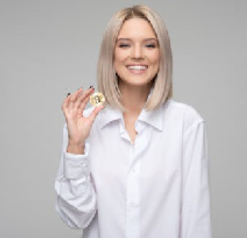
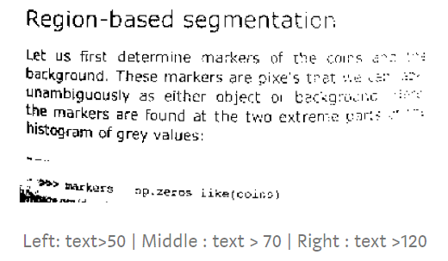
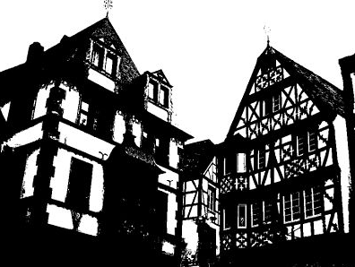
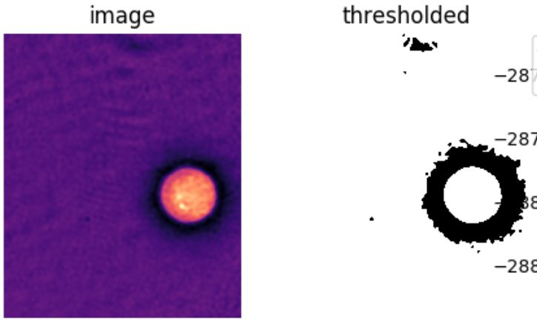
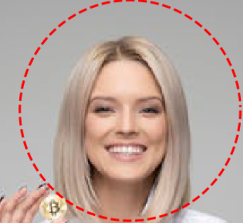
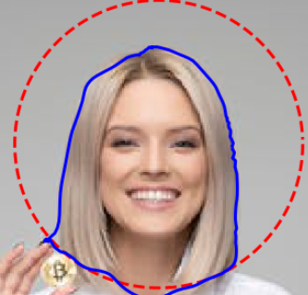
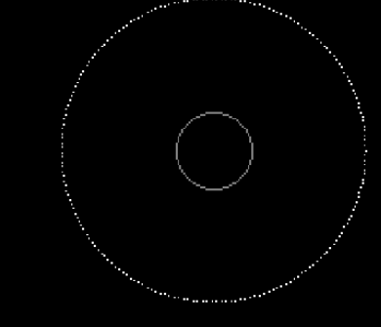
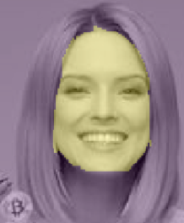

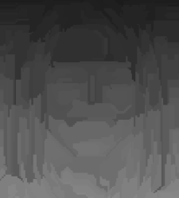
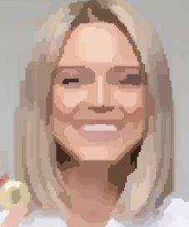
Load Image
*Histogram
Supervised
Set the thresholding value
Thresholding
otsu
Pre-Segmentation
Unsupervised
li
De-noise
local
Active Contour
(‘Snake’)
Supervised
Bigger Range
Random Walker
+ Labeled Image
Segmentation
Smaller Range
SLIC
( Simple Linear Iterative Clustering)
(K-means)
Unsupervised
Felzenszwalb
(minimum-spanning tree clustering)
* Re-color

Slide 2
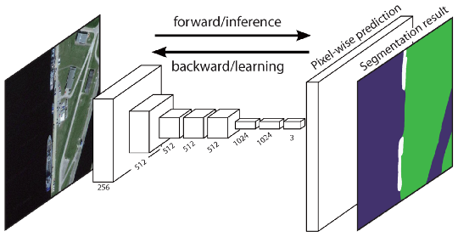
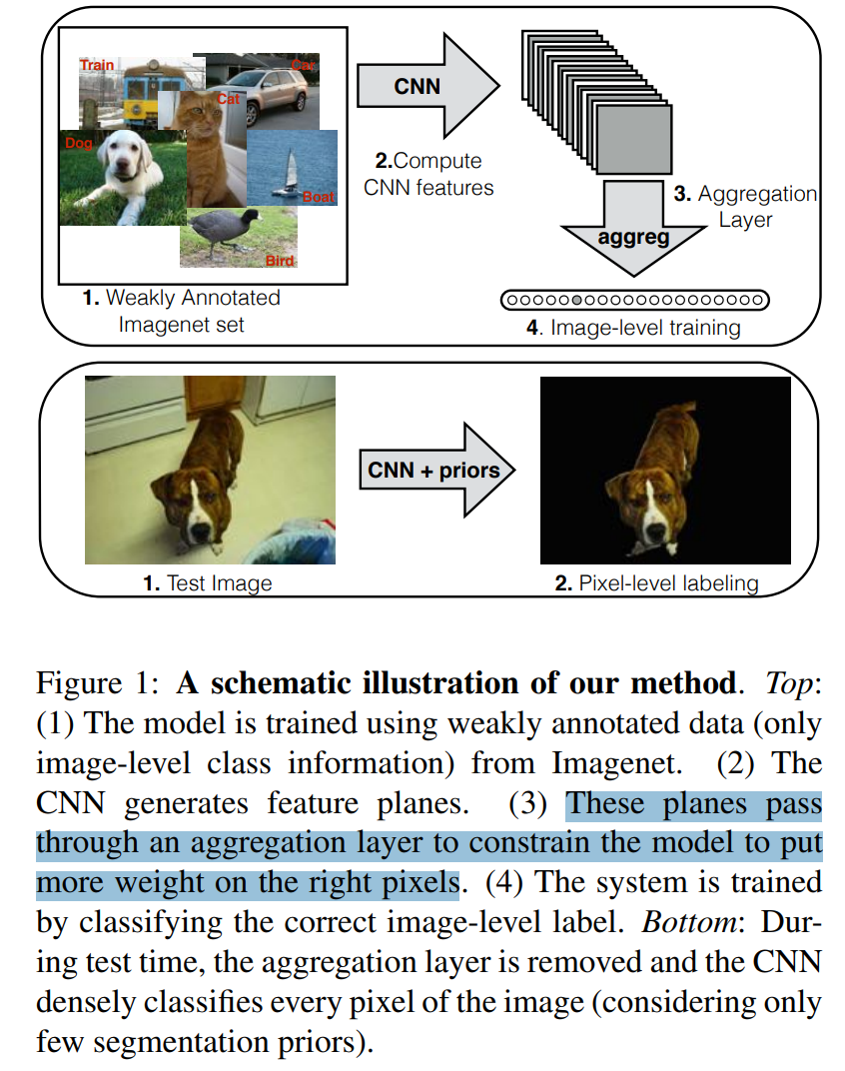
Fully Convolutional Network (FCN)
The FCN network pipeline is an extension of the classical CNN.
Learns a mapping from pixels to pixels, without extracting the region proposals.
FCNs only have convolutional and pooling layers which give them the ability to make predictions on arbitrary-sized inputs.
Issue:
the direct predictions of FCN are typically in low resolution, resulting in relatively fuzzy object boundaries.
Solve this by advanced FCN:
SegNet, DeepLab-CRF, and Dilated Convolutions.
Weakly Supervised Semantic Segmentation
Problem:
manually annotating these masks is quite time-consuming, frustrating and commercially expensive
How:
fulfilling the semantic segmentation by utilizing annotated bounding boxes.
explored recursive training as a de-noising strategy
Simple Does It
Pixel-level Labeling
interpreted the segmentation task within the multiple-instance learning framework
added an extra layer to constrain the model
assign more weight to important pixels for image-level classification.

Slide 3
FCN architecture
VGG16
fully convolutional layers:
1x1 convolution
A class
presence heat map
(low resolution)
upsampling
transposed convolutions:
initialized with
bilinear interpolation filters

Slide 4
encoder
pre-trained classification network:
e.g.: VGG / ResNet etc.
decoder
project the discriminative features (lower resolution) learnt by the encoder onto the pixel space (higher resolution) to get a dense classification.
dense classification
Region-Based Semantic Segmentation
extract a large quantity of object proposals
dense classification
R-CNN
benchmark structure
computes CNN features
for each of them
classifies each region using
the class-specific linear SVMs
Fully Convolutional Network (FCN)
convolutional and
pooling layers
learns a mapping from pixels to pixels
classical CNN take as input
arbitrary-sized images
Weakly Supervised Semantic Segmentation
Boxsup
Pixel-level Labeling
Utilizing weakly annotation

